Slide 1
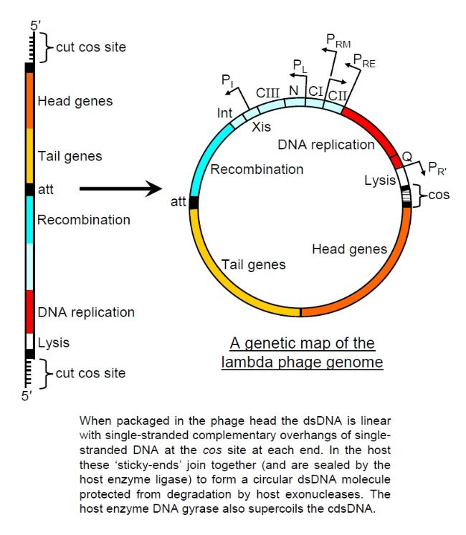
Expected Results
Known locations of genes; no need to debate about start site locations.
Process would mostly be related to finding evidence for functions and protein products of various genes.
Functions of genes would be related to placement in genome; not many would have unknown functions.
Photo from http://cronodon.com/sitebuilder/images/lambda_1-650x747.jpg

Slide 2
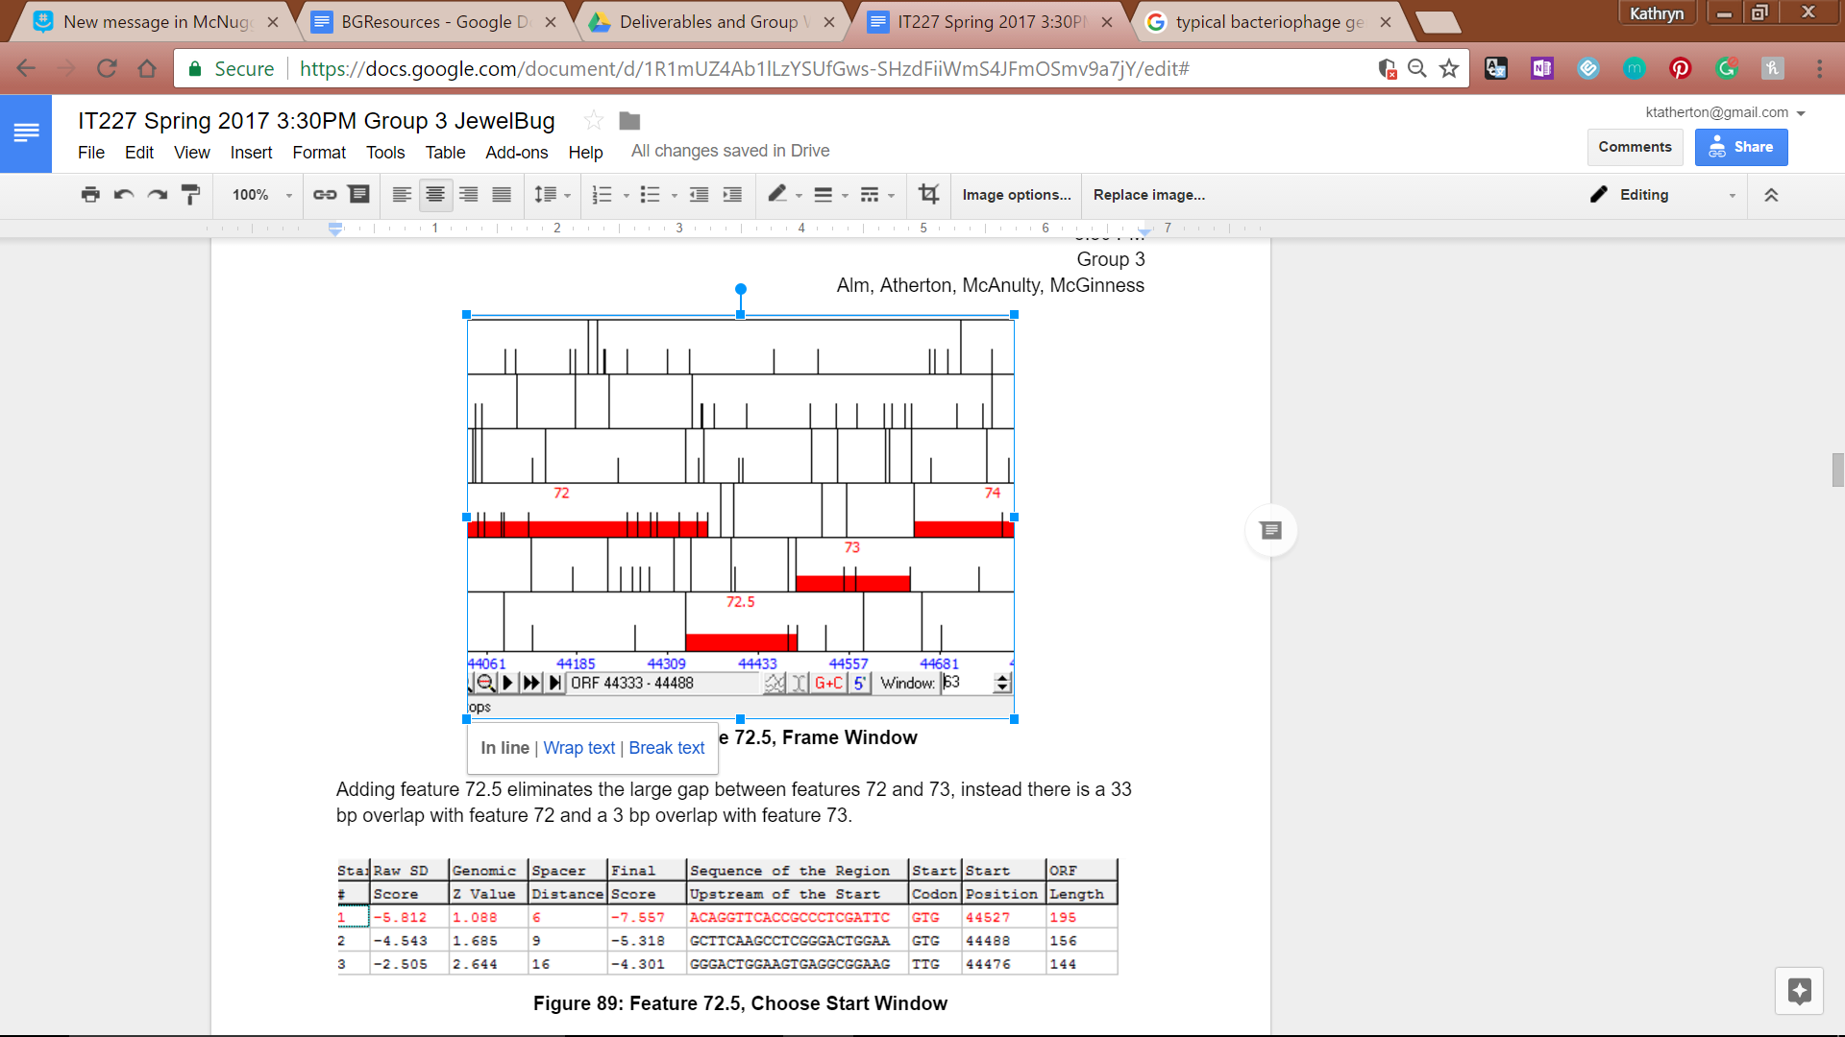
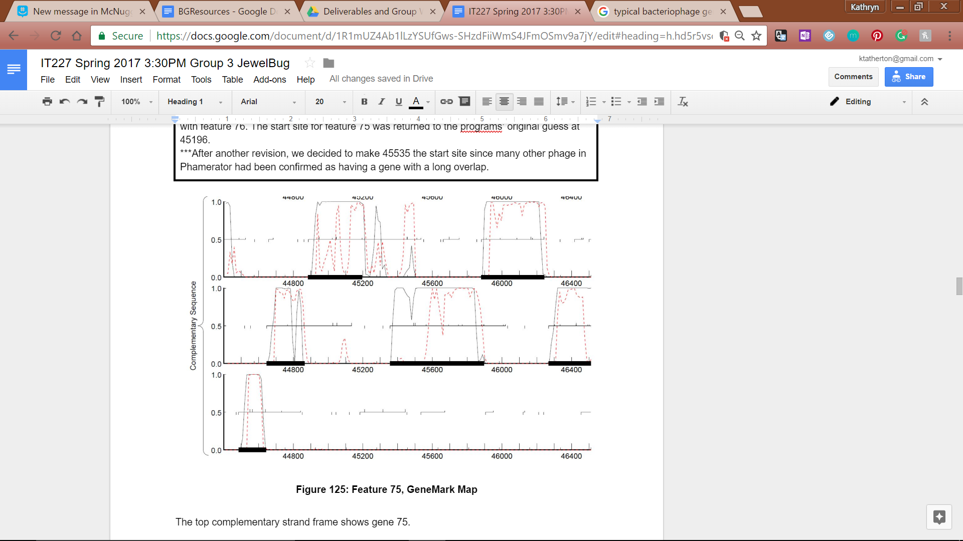
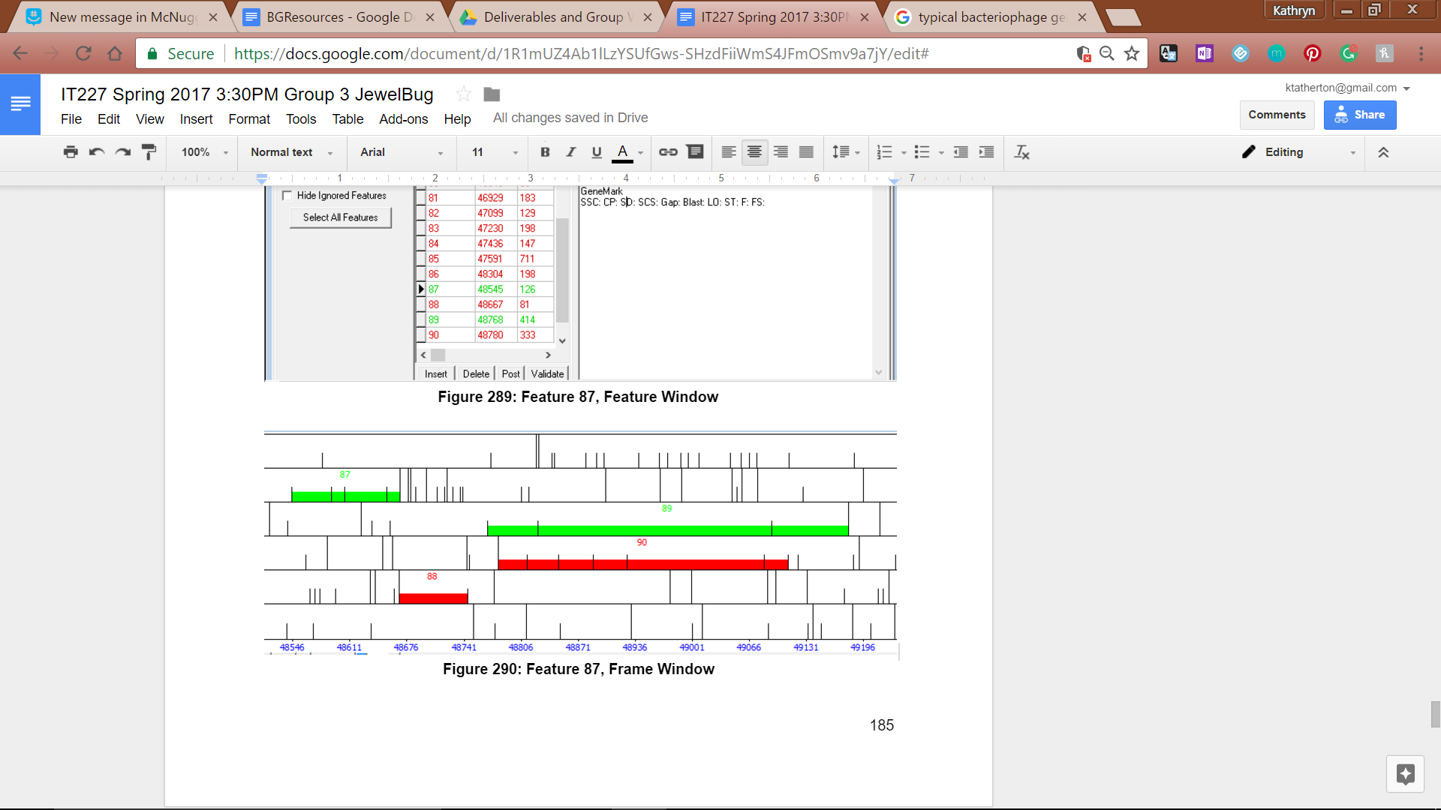
Results of Project
Addition of a Feature: There was a region in the genome that had a high amount of coding potential and an area in which a feasible start and stop site could be added.
Lengthening a Feature: Feature 75 (top left corner of above picture) showed an ability to be lengthened to cover more coding potential, but the program called to cut it short. Despite the elongation causing a larger-than-usual overlap with the next gene, enough evidence existed to allow for this bending of the rule.
Deletion of Two Features: Two forward-running genes at the very end of the gene were out of place (a change in direction requires a 50 bp gap on either side of the gene) and thus were deleted, as they had very little evidence supporting their existence
A story of changing the ending.

